Slide 1


Taking the 3 Ways on the Road
Alex Moore
System Build Engineer
TransUnion (formerly Callcredit)
Alexandra.Moore@callcreditgroup.com
Twitter: @smileandeliver

Slide 2

@smileandeliver

Slide 3
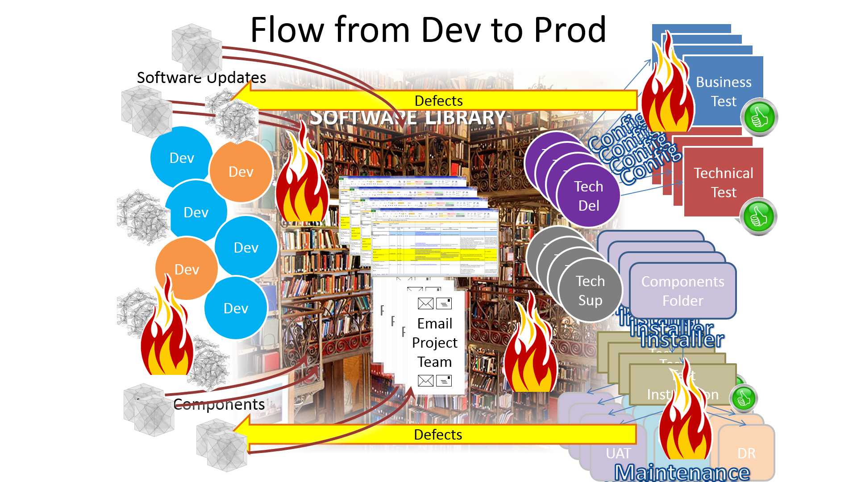
@smileandeliver

Slide 4







awesome
DEPLOYMENT
Software
fast
QA
Flow
Culture
automation
Improvement
DevOps
Measuring
COLLABORATION
Continuous
Pipeline
Developers
Reliable repeatable Reproducible
@smileandeliver

Slide 5
awesome
DEPLOYMENT
Software
fast
QA
Flow
Culture
automation
Improvement
DevOps
Measuring
COLLABORATION
Continuous
Pipeline
Developers
Reliable repeatable Reproducible
@smileandeliver

Slide 6

Dev
Ops
Dev
Ops
Dev
Ops
@smileandeliver

Slide 7

CULTURE
@smileandeliver

Slide 8
“All the Gear and No Idea”
-Are we too obsessed with tools?
@smileandeliver

Slide 9
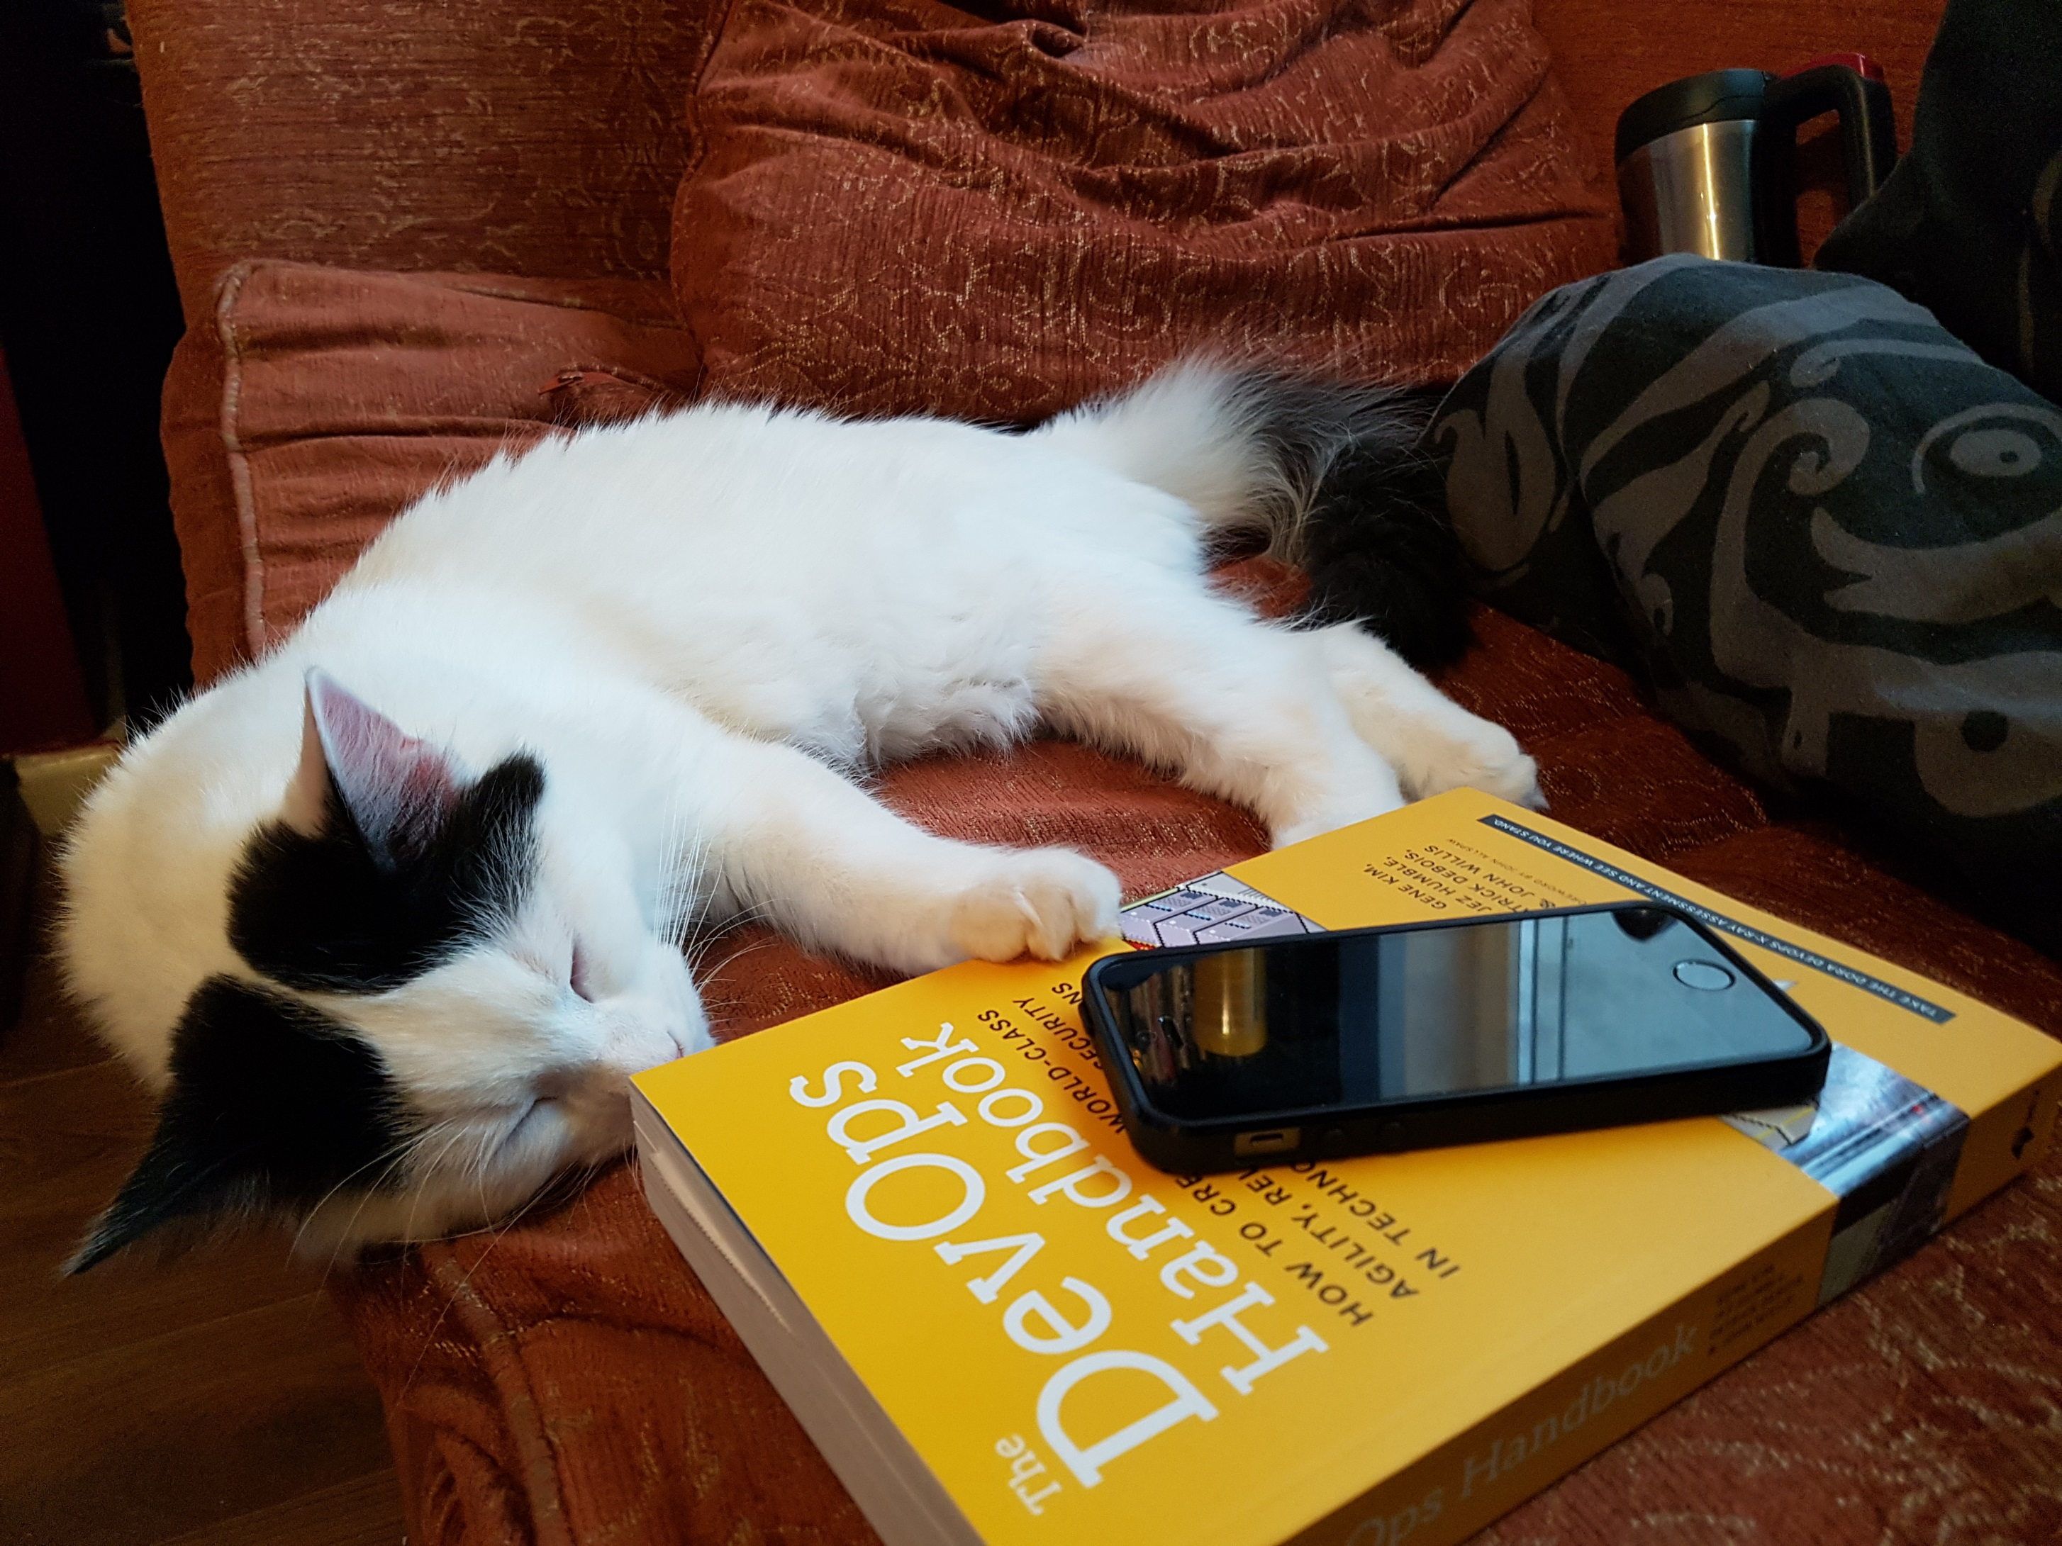
@smileandeliver

Slide 10

“Testing Is DevOps”
@smileandeliver

Slide 11
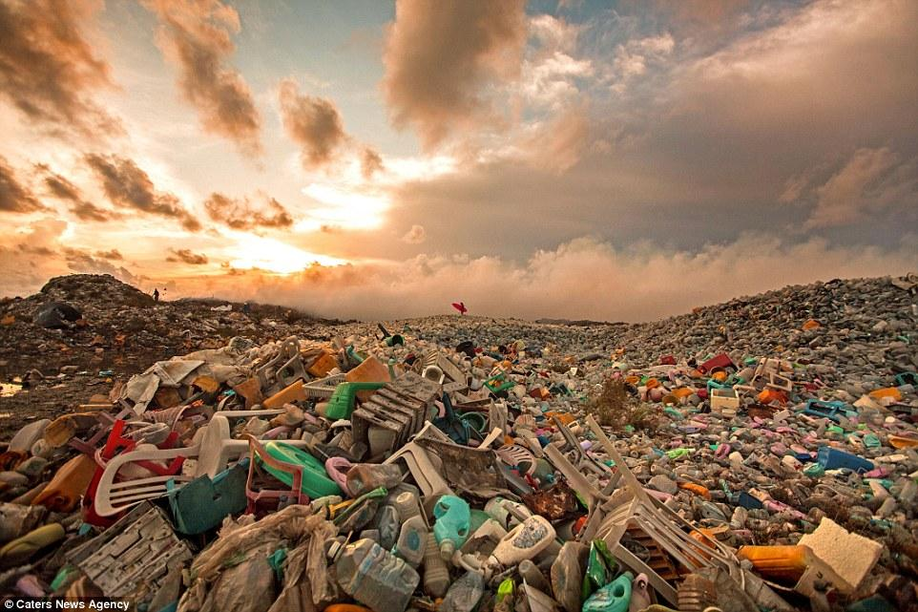
@smileandeliver

Slide 12






Culture
Metrics
Lean
Automation
Sharing
@smileandeliver

Slide 13



Three Ways of DevOps
@smileandeliver

Slide 14
God
Reporter
Genius
@smileandeliver

Slide 15

Gods
The First Way
Systems Thinking
The Second Way
Reporters
Amplify Feedback Loops
The Third Way
Geniuses
Culture of continual experimentation and learning
@smileandeliver
Notes:
Feedback from each group, get them to talk through their ideas briefly

Slide 16

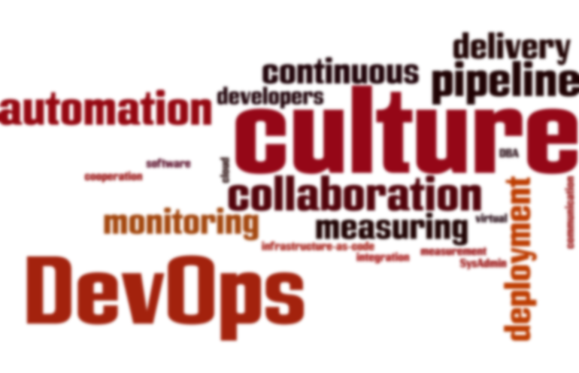
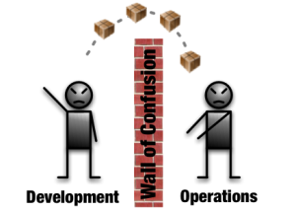

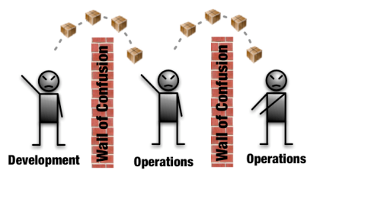
@smileandeliver
#TEAMS
Notes:
All the classic ‘why devops’ stuff

Slide 17


Dev
Ops
Dev
Ops
Dev
Ops
@smileandeliver

Slide 18
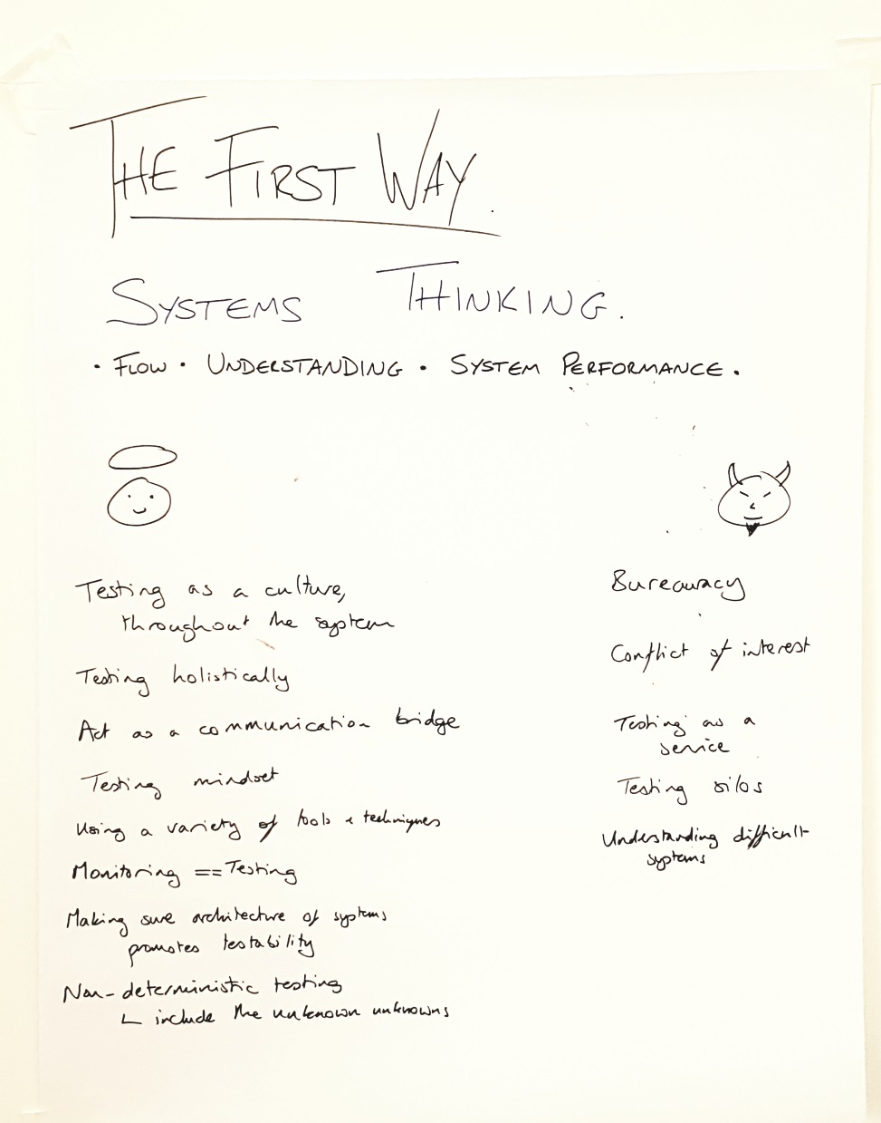
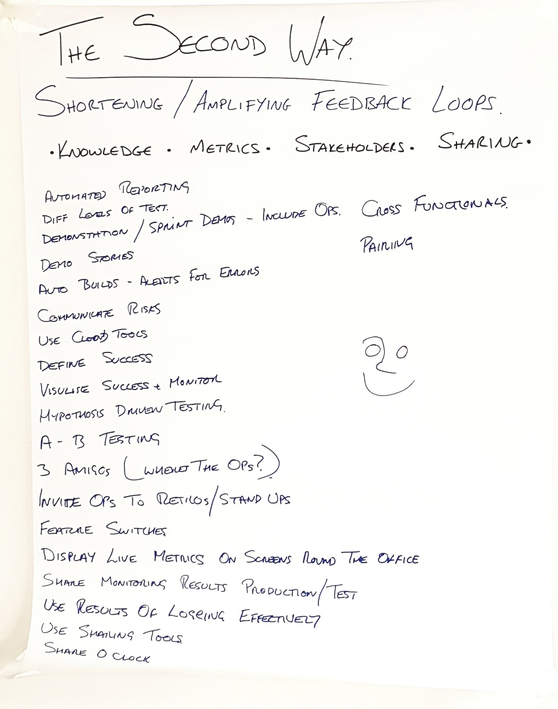
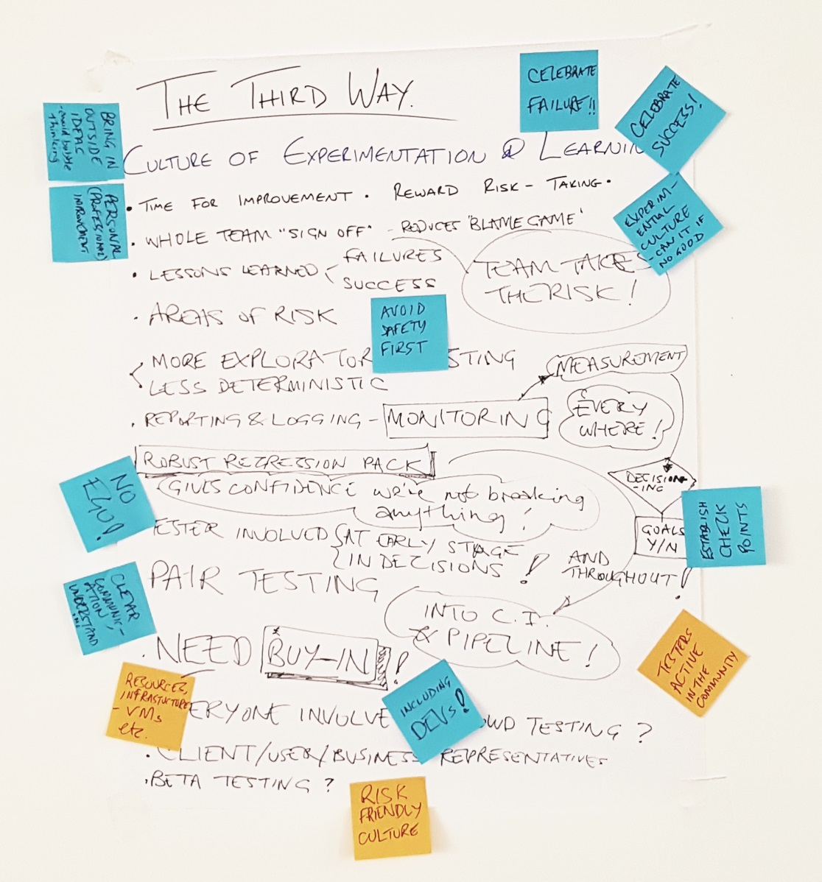
@smileandeliver

Slide 19
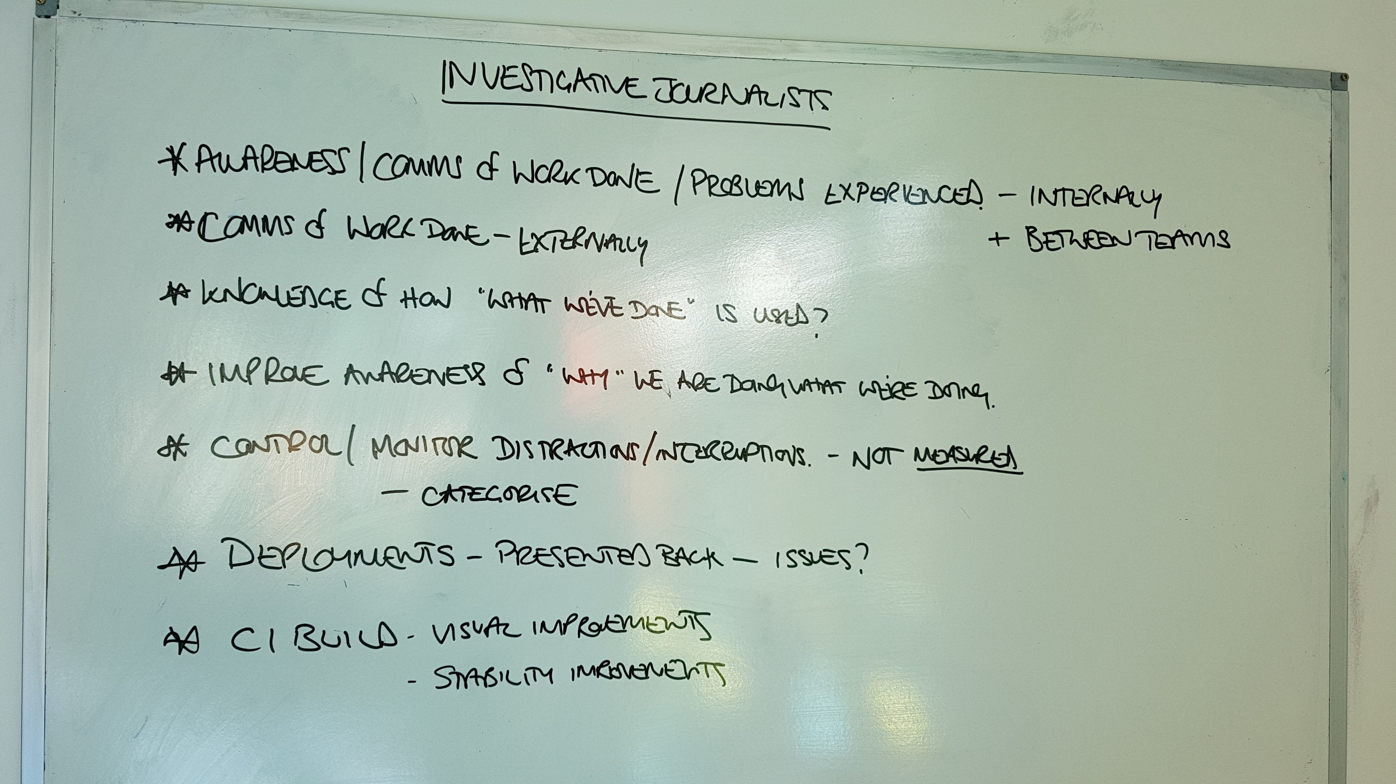
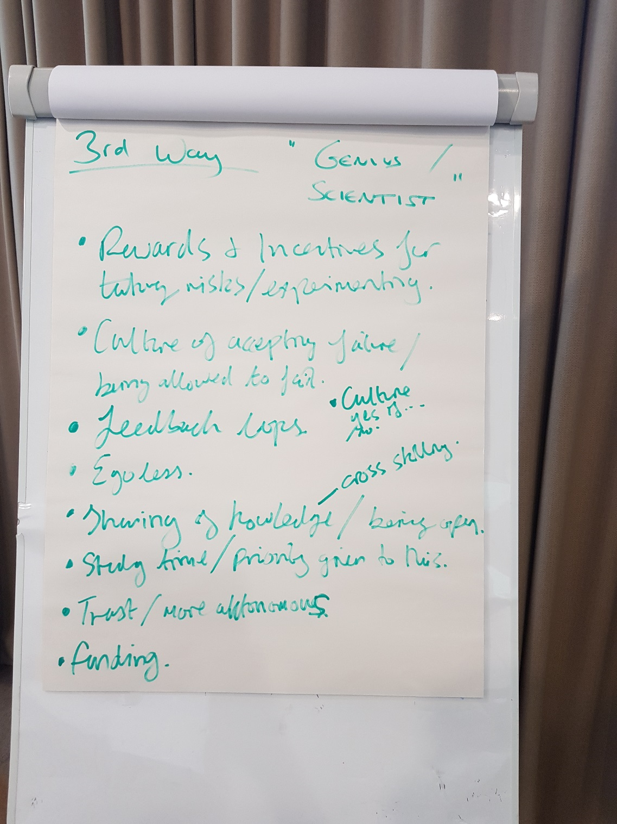
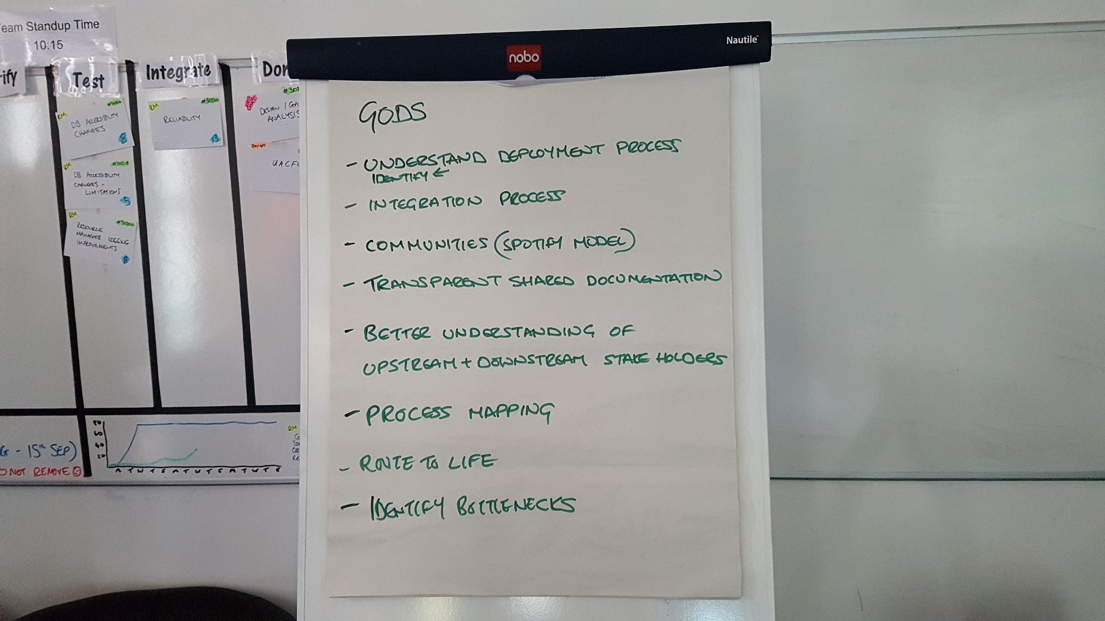
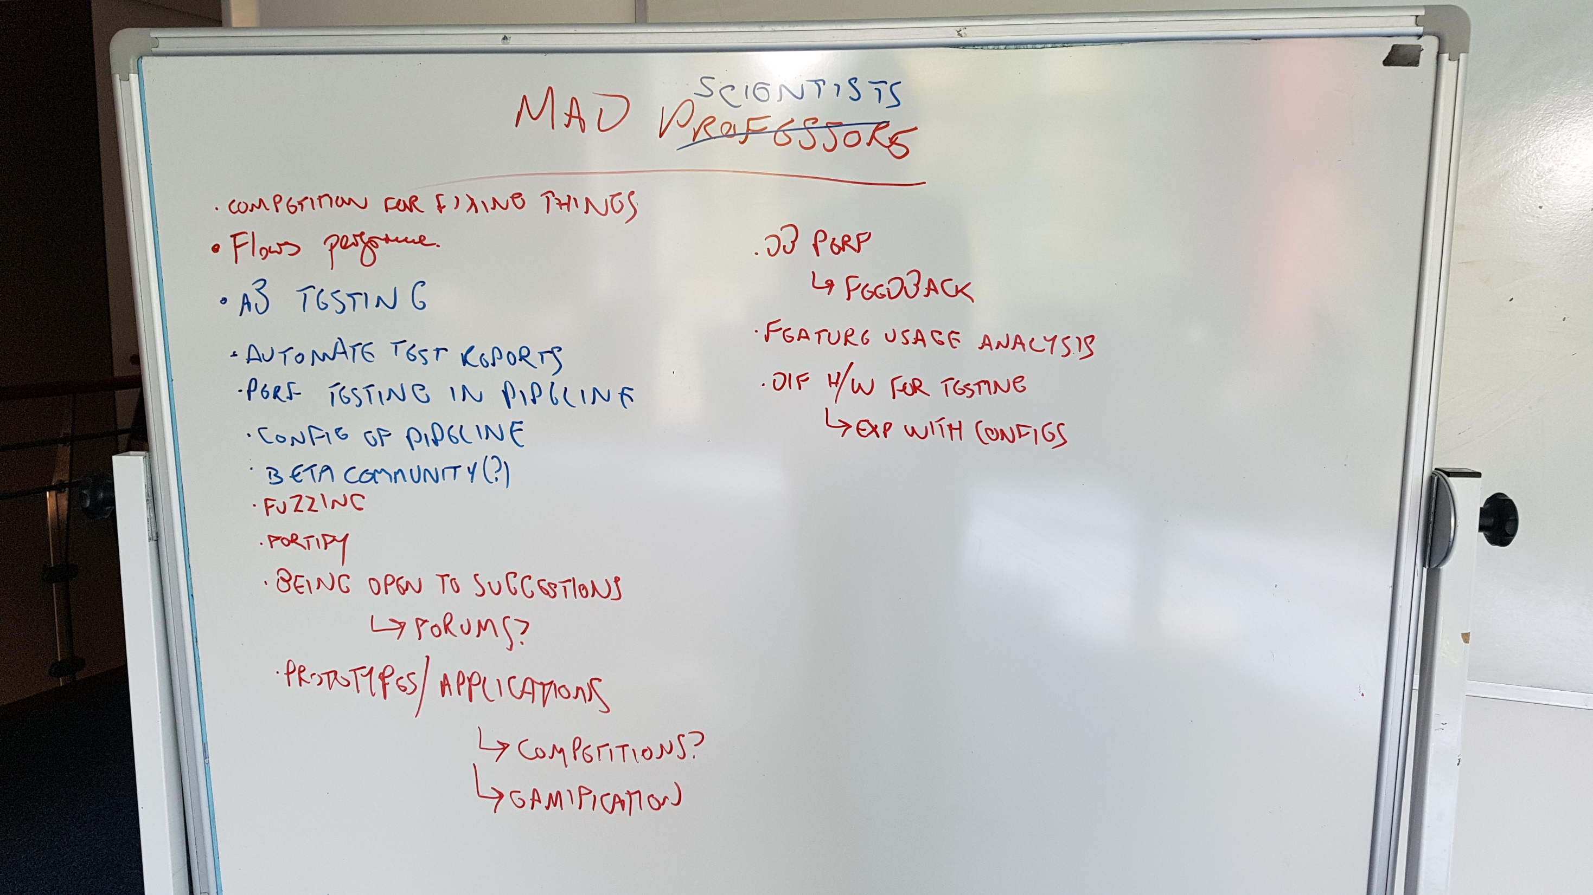
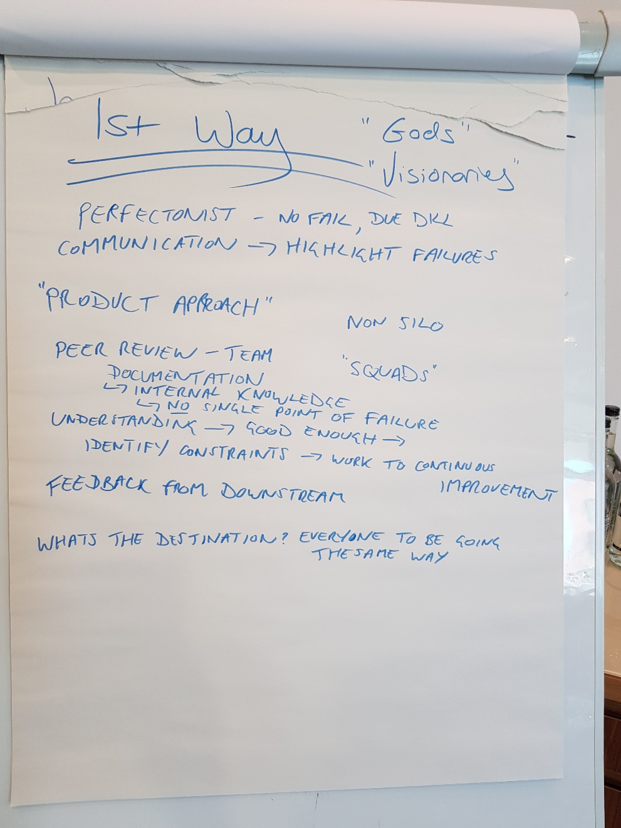
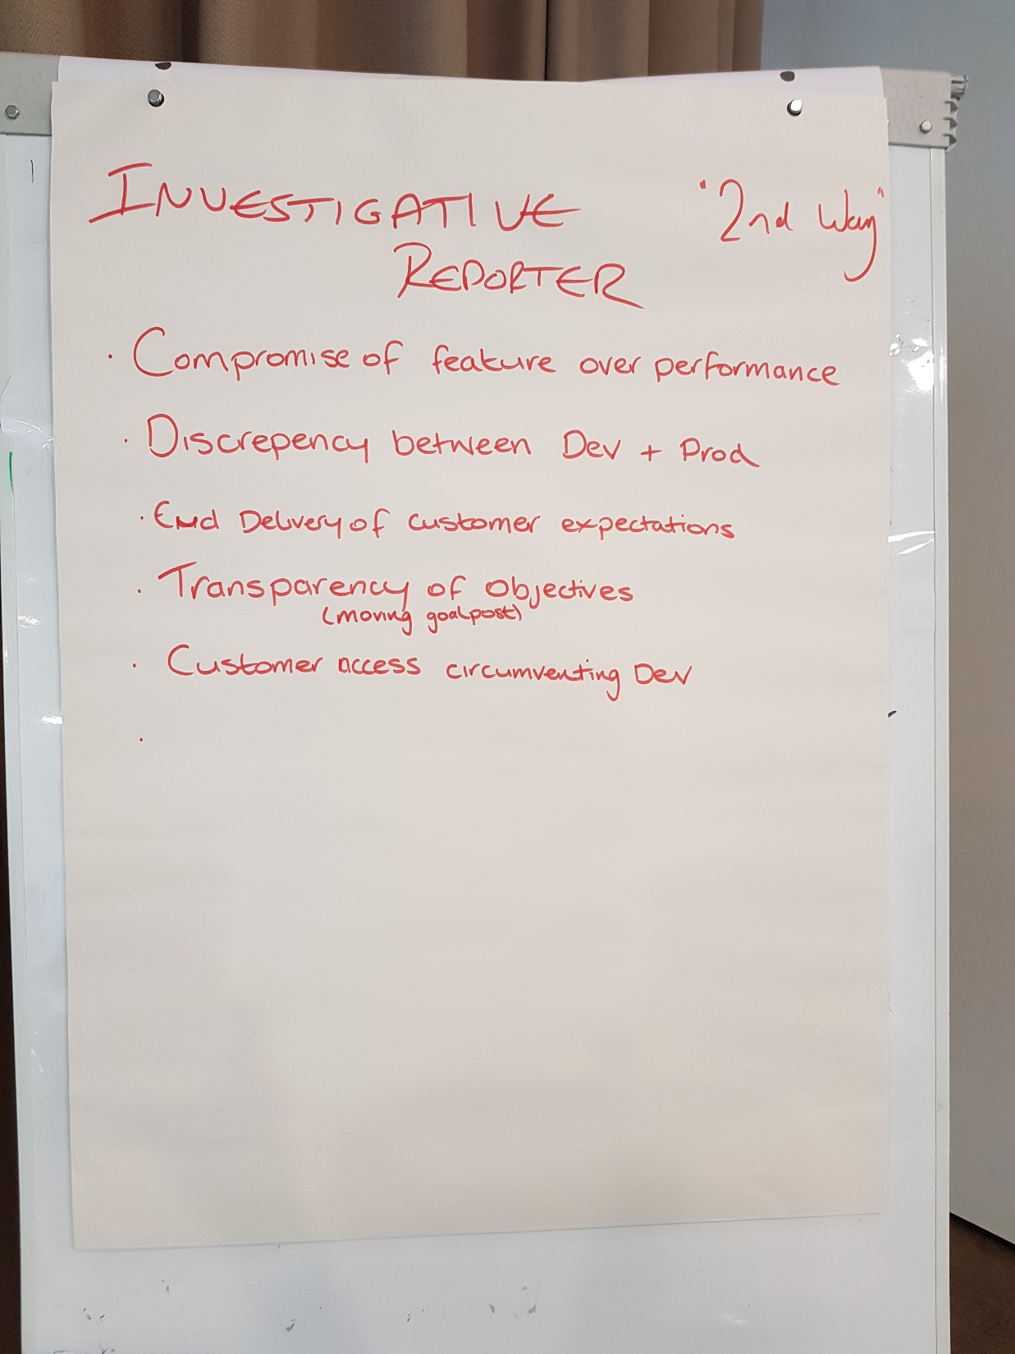
@smileandeliver

Slide 20

Header
@smileandeliver
https://github.com/smileandeliver/
Notes:
Thank you and please come forward with any questions

